Slide 1
Student Performance Analysis using Excel
STUDENT NAME: Ajithapriya. D
REGISTER NO:312204076
NM I’d : 1502A90DC6CF530A5D24BE701C0564B1
DEPARTMENT: Commerce
COLLEGE: Sriram College Of Arts & Science

Slide 2
PROJECT TITLE
Student Performance Analysis using Excel

Slide 3


AGENDA
Problem Statement
Project Overview
End Users
Our Solution and Proposition
Dataset Description
Modelling Approach
Results and Discussion
Conclusion
3/21/2024 Annual Review

Slide 4

PROBLEM STATEMENT
The goal is to analyze and predict the academic performance of students using a variety of factors that may influence their success. These factors could include demographic information, previous academic records, attendance rates, participation in extracurricular activities, and socio-economic background. By identifying key predictors of academic success, educational institutions can develop targeted interventions to help underperforming students improve their grades and overall academic experience.

Slide 5

PROJECT OVERVIEW
Student performance refers to the evaluation and assessment of a student’s professionalism, participation, literature evaluation, role-play performance, and cumulative essay final examination. It encompasses both formative and summative assessments in these areas to determine the student’s overall course grade.

Slide 6
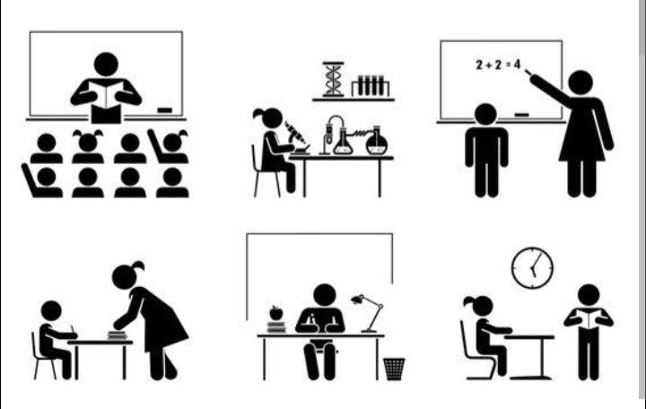

WHO ARE THE END USERS?
1 . Principal
2 . Teacher
3 . Parents
4 . Student
5 . Academic Research

Slide 7

OUR SOLUTION AND ITS VALUE PROPOSITION
Comprehensive Data Analysis:
We collect and process data from multiple sources, ensuring a holistic view of each student's academic journey. This includes grades, attendance records, behavior reports, and socio-economic data.
Improved Student Performance:
By identifying and addressing the needs of at-risk students early, our solution helps to reduce dropout rates, increase graduation rates, and improve overall academic performance.
Personalized Education:
We enable schools to offer more personalized educational experiences. By understanding each student's unique needs, educators can tailor their teaching strategies to optimize learning outcomes.

Slide 8
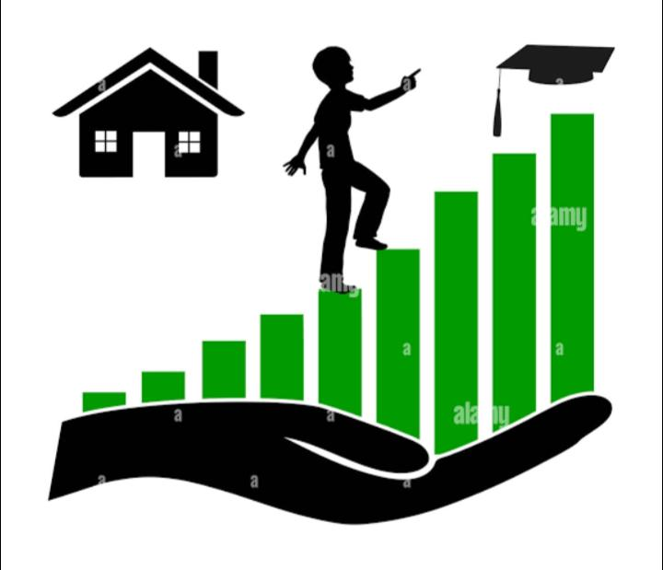
Dataset Description
Student ID: Unique identifier for each
Age: Age of the student.
Gender : Gender of the student (e.g., Male, Female, Non-binary).
Current Grades: Grades in ongoing courses, including mid-term and final exam scores.
Attendance Rate: Percentage of classes attended by the student.
Extracurricular Activities:
Participation in Clubs/Sports: Involvement in school clubs, sports teams, or other extracurricular activities.
Parental Involvement: Indicators of parental engagement in the student’s education (e.g., attendance at parent-teacher meetings, homework help).

Slide 9

THE "WOW" IN OUR SOLUTION
Holistic Student Profiles:
Our solution builds comprehensive, 360-degree profiles of each student, incorporating academic records, behavioral data, socio-economic background, and even psychological factors.
Real-Time Insights and Visualization :
We provide real-time, dynamic dashboards that present data in an intuitive, easy-to-understand format. Educators can visualize trends, identify at-risk students, and monitor the impact of interventions as they happen.
3/21/2024 Annual Review
9

Slide 10

MODELLING
Modeling student performance involves developing predictive models that can forecast academic outcomes based on various factors. These models can help identify at-risk students, uncover key drivers of success, and provide actionable insights for educators.
Target Variable:
The primary outcome you want to predict, such as the final grade in a course or overall GPA.
Data Cleaning:
Handle missing data (e.g., imputation, removal), remove duplicates, and correct errors in the dataset.
10

Slide 11
RESULTS
11

Slide 12

conclusion
The analysis and prediction of student performance represent a transformative approach to education. By leveraging advanced data analytics and machine learning, educators can gain a deeper understanding of the factors that influence academic outcomes and identify students who may be at risk of underperforming. This proactive, data-driven methodology allows schools to move from reactive interventions to personalized and timely support strategies that directly address the unique needs of each student.

